Slide 1
ONLINE LEARNING (AI-AGENT)
SlideMake.com

Slide 2
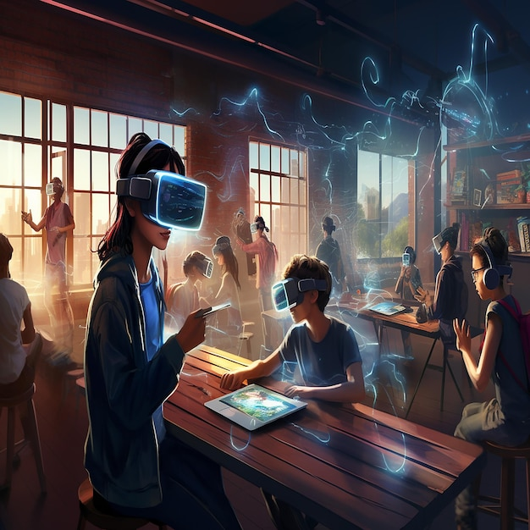
Introduction to Online Learning
Online learning has transformed the educational landscape by providing access to education anytime and anywhere.
With the integration of technology, traditional classrooms have evolved into dynamic virtual environments.
This presentation explores the role of AI agents in enhancing online learning experiences.
Notes:
Image source: https://img.freepik.com

Slide 3
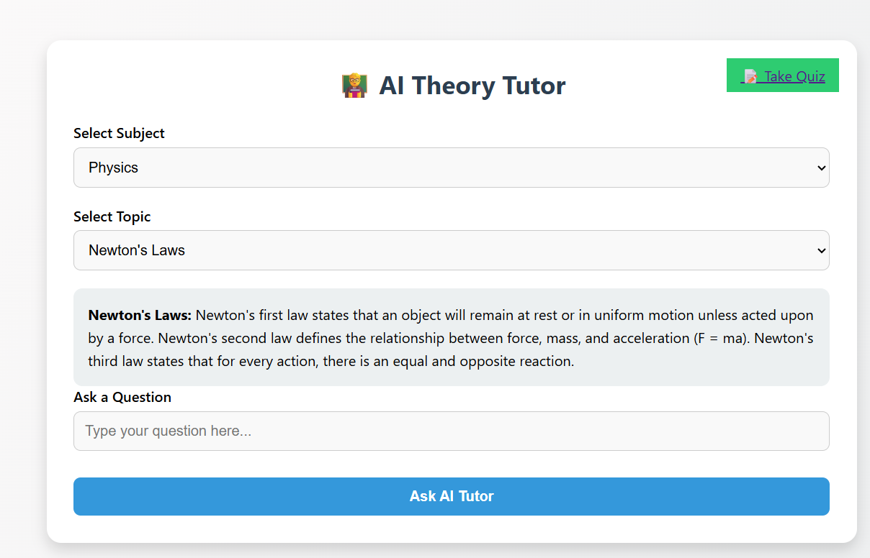

The Rise of Online Learning
Online learning has gained popularity due to its flexibility and convenience for learners.
Many educational institutions have adopted online platforms to reach a wider audience.
The COVID-19 pandemic accelerated the shift towards online education, highlighting its potential.
Notes:
Image source: https://www.slidemake.com

Slide 4
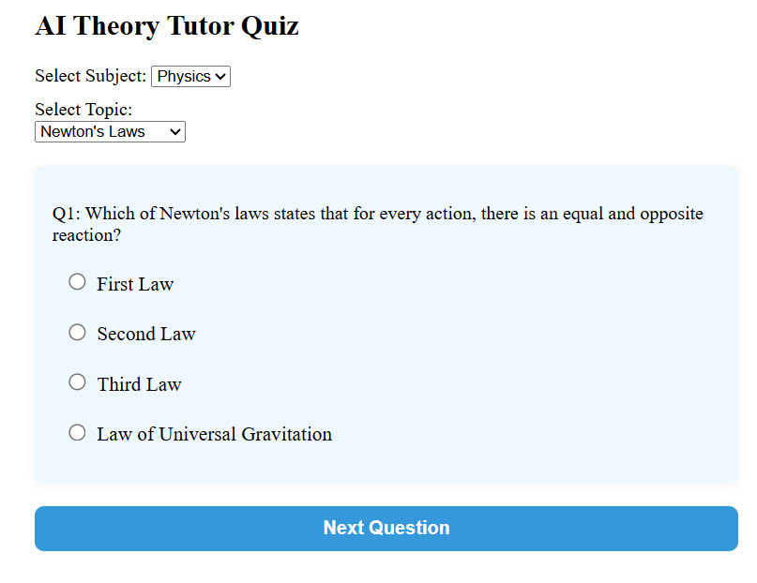
Defining AI Agents
AI agents are software systems that can perform tasks autonomously by simulating human intelligence.
They can analyze data, learn from experiences, and adapt to different learning environments.
In education, AI agents facilitate personalized learning and improve student engagement.
Notes:
Image source: https://www.slidemake.com

Slide 5
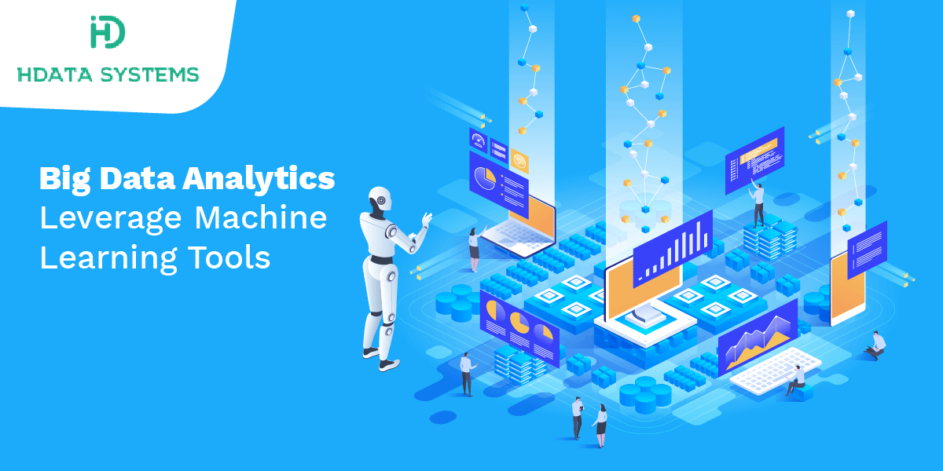
Personalized Learning Experiences
AI agents leverage data analytics to tailor educational content to individual learner needs.
They can identify strengths and weaknesses, enabling targeted interventions for each student.
This customization enhances motivation and fosters a more effective learning journey.
Notes:
Image source: https://www.hdatasystems.com

Slide 6
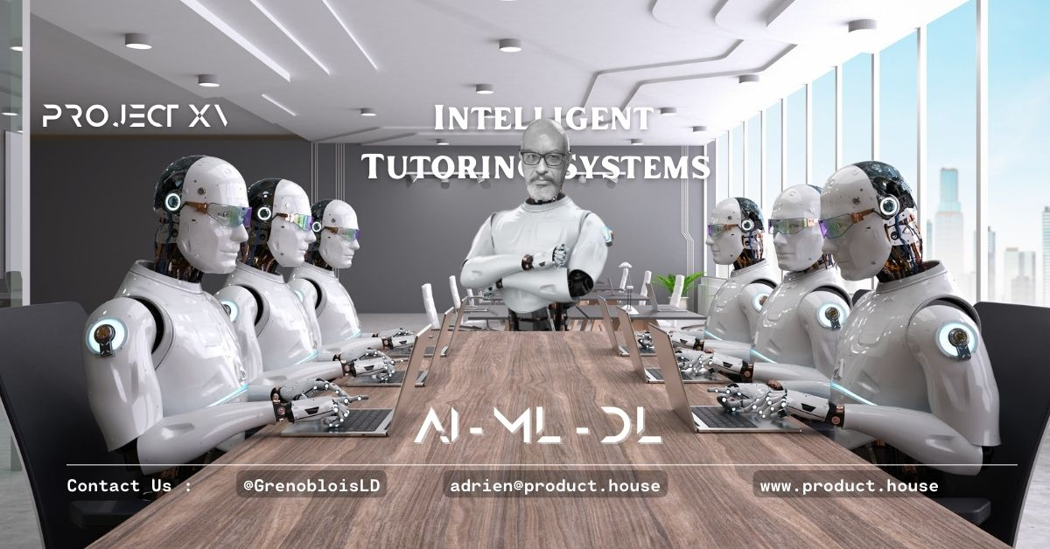
Intelligent Tutoring Systems
AI agents can act as virtual tutors, providing real-time feedback and support to learners.
These systems utilize natural language processing to understand and respond to student queries.
Intelligent tutoring fosters a collaborative learning atmosphere, even in an online setting.
Notes:
Image source: https://product.house

Slide 7
Enhancing Content Delivery
AI agents can curate and recommend educational resources based on student interests and performance.
They can adapt the presentation of material, ensuring that it is engaging and comprehensible.
This dynamic content delivery keeps students motivated and encourages active participation.
Notes:
Image source: https://www.slidemake.com

Slide 8

Data-Driven Insights
AI agents collect and analyze vast amounts of data to inform instructional decisions.
Educators can gain insights into student progress and overall course effectiveness.
These analytics enable continuous improvement of online learning programs and strategies.
Notes:
Image source: https://thumbs.dreamstime.com

Slide 9

Challenges of AI in Online Learning
Despite its advantages, the integration of AI agents presents challenges such as data privacy concerns.
There is also the risk of over-reliance on technology, which may hinder critical thinking skills.
Educators must balance AI tools with traditional teaching methods to maintain educational integrity.
Notes:
Image source: https://www.zanoma.com

Slide 10
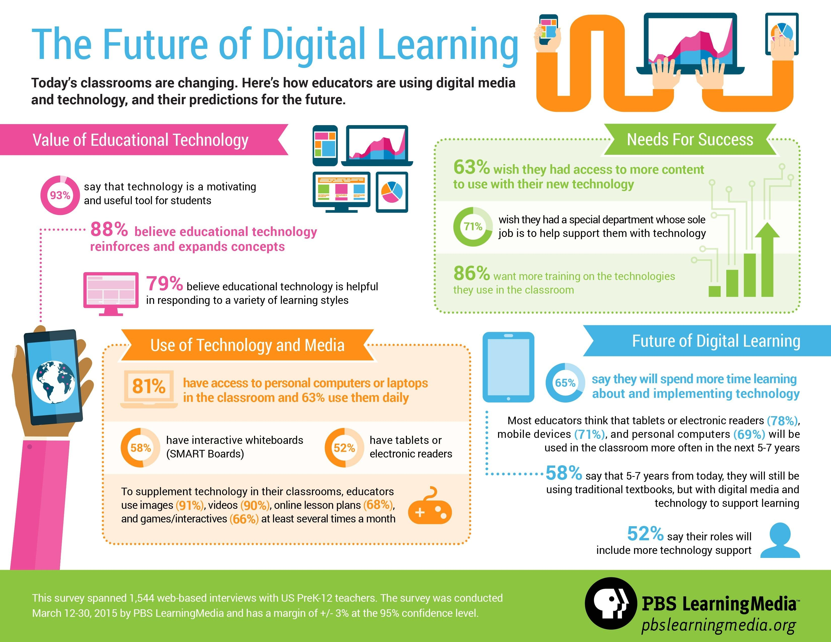
Future Trends in Online Learning
The future of online learning will likely see increased collaboration between AI agents and educators.
Advancements in AI technology will further enhance personalized learning experiences.
As online education continues to evolve, integrating AI will become essential for effective teaching.
Notes:
Image source: https://edtechdigest.blog

Slide 11

Conclusion
Online learning, supported by AI agents, offers unprecedented opportunities for education.
The combination of technology and personalization can significantly improve learning outcomes.
Embracing these innovations is crucial for preparing learners for the demands of the future.
Notes:
Image source: https://thumbs.dreamstime.com

